Slide 1

Terraform
Infrastructure as Code

Slide 2






AWS Cloud
Requirements: without terraform
3 environments – DEV, TST, PRD
Dev
1 server = t2.small
TST
1 server = t2.small
PRD
2 servers = t2.medium
t2.medium
t2.medium
→ t2.large
NON-PRD ACCOUNT
PRD ACCOUNT
DEV
TST
PRD
Dev-instance-1
Tst-instance-1
Prd-instance-1
t2.small
t2.small
t2.medium
t2.medium
t2.medium
t2.large
Prd-instance-2
t2.medium
t2.large

Slide 3





AWS Cloud
Requirements: without terrform
3 environments – DEV, TST, PRD
Dev
1 server
t2.medium
TST
1 server
t2.medium
PRD
2 servers
t2.large
2 servers
t2.large
x100
2 servers
t3.large
4 servers
m5.xlarge
NON-PRD ACCOUNT
PRD ACCOUNT
DEV
TST
PRD
Dev-instance-1
Tst-instance-1
Prd-instance-1
Prd-instance-3
t2.medium
t2.medium
t2.large
m5.xlarge
t2.large
t3.large
m5.xlarge
Dev-instance-2
Tst-instance-2
Prd-instance-2
Prd-instance-4
t2.large
t3.large
t2.large
m5.xlarge
m5.xlarge

Slide 4

Fast forward 6 months…

Slide 5
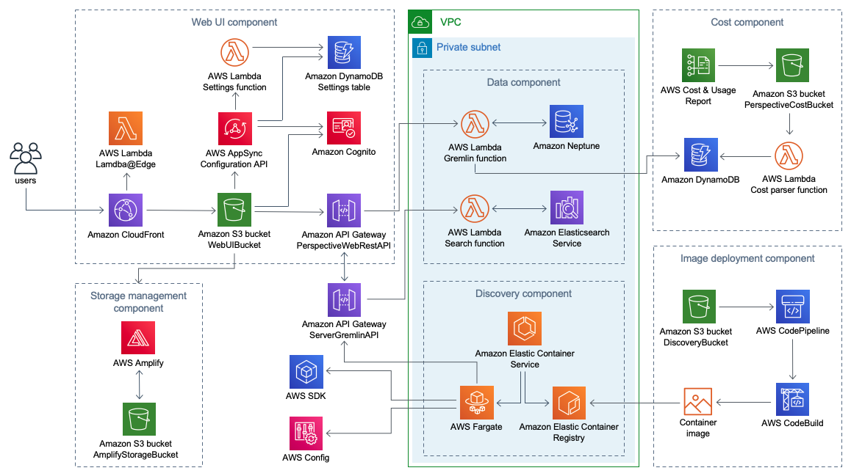



Infrastructure now has additional resources e.g. database, alb, autoscaling, etc – all manually created across multiple environments.
Nobody remembers exactly what they did in each environment
And now…
new employee to train

Slide 6

What is terraform?
Terraform to the rescue
Terraform is a tool for building, changing, and versioning infrastructure
Write - configuration files describes components needed to run a single application
Plan - describes what it will do to reach the desired state
Apply - executes it to build the described infrastructure.

Slide 7
Benefits of using terraform
Automation
Documentation
Validation
Version Control
Reuse

Slide 8




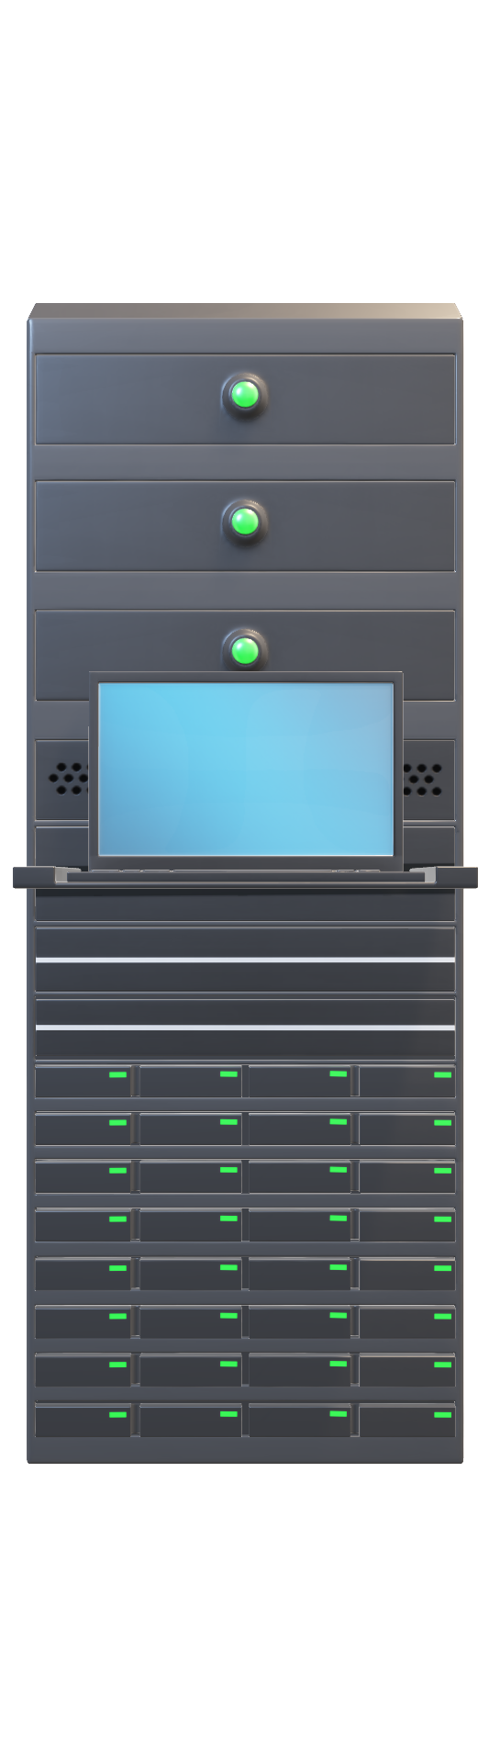

Automation
Let terraform do it for you
Aws Infrastructure
dev
Dev Configuration
Environment = Dev
Instance Count = 1
Instance Size = t2.small
Dev-instance-1
t2.small
deployment process can be automated
tst
Tst Configuration
Environment = tst
Instance Count = 1
Instance Size = t2.small
Tst-instance-1
t2.small
Speed - computer can carry out the deployment
prd
Prd Configuration
Environment = prd
Instance Count = 2
Instance Size = t2.medium
prd-instance-1
prd-instance-2
Safety - automated process will be more consistent, more repeatable, and not prone to manual error.
t2.medium
t2.medium

Slide 9
Benefits of using terraform
Automation
Documentation
Validation
Version Control
Reuse

Slide 10
Documentation
Terraform Folder Structure
How does it work?
Infrastructure
Environments
Dev
Database
variables.tfvars
terragrunt.hcl
EC2-Instance
terragrunt.hcl
variables.tfvars
Tst
Database
Variables.tfvars
Terragrunt.hcl
EC2-Instance
Variables.tfvars
Terragrunt.hcl
Prd
Database
Variables.tfvars
Terragrunt.hcl
EC2-Instance
Variables.tfvars
Terragrunt.hcl
General Resources
Non-prd
Account.tfvars
General.tfvars
Global.tfvars
Prd
Account.tfvars
General.tfvars
Global.tfvars
Modules
Database
Main.tf
Outputs.tf
Vars.tf
EC2-Instance
Main.tf
Outputs.tf
Vars.tf
Create an ec2 instance
Here’s what I want
ec2-Instance dev environment variables
{
“Instance-count”: 1
“environment”: “dev”
“Instance-type”: “t2.small”
}

Slide 11
Documentation
How environment variables are defined
Infrastructure
Environments
Dev
Database
variables.tfvars
terragrunt.hcl
EC2-Instance
variables.tfvars
terragrunt.hcl
Tst
Database
Variables.tfvars
Terragrunt.hcl
EC2-Instance
Variables.tfvars
Terragrunt.hcl
Prd
Database
Variables.tfvars
Terragrunt.hcl
EC2-Instance
Variables.tfvars
Terragrunt.hcl
General Resources
Non-prd
Account.tfvars
General.tfvars
Global.tfvars
Prd
Account.tfvars
General.tfvars
Global.tfvars
Modules
Database
Main.tf
Outputs.tf
Vars.tf
EC2-Instance
Main.tf
Outputs.tf
Vars.tf
ec2-Instance dev environment variables
{
“Instance-count”: 1
“environment”: “dev”
“Instance-type”: “t2.small”
}
ec2-Instance tst environment variables
{
“Instance-count”: 1
“environment”: “tst”
“Instance-type”: “t2.small”
}
ec2-Instance prd environment variables
{
“Instance-count”: 2
“environment”: “prd”
“Instance-type”: “m5.large”
}
Represent the state of your infrastructure in source files that anyone can read

Slide 12
Documentation
How does it work?
What’s in the modules?
Infrastructure
Environments
Dev
Database
variables.tfvars
terragrunt.hcl
EC2-Instance
variables.tfvars
terragrunt.hcl
Tst
Database
Variables.tfvars
Terragrunt.hcl
EC2-Instance
Variables.tfvars
Terragrunt.hcl
Prd
Database
Variables.tfvars
Terragrunt.hcl
EC2-Instance
Variables.tfvars
Terragrunt.hcl
General Resources
Non-prd
Account.tfvars
General.tfvars
Global.tfvars
Prd
Account.tfvars
General.tfvars
Global.tfvars
Modules
Database
Main.tf
Outputs.tf
Vars.tf
EC2-Instance
Main.tf
Outputs.tf
Vars.tf
ec2-Instance dev environment variables
{
“Instance-count”: 1
“environment”: “dev”
“Instance-type”: “t2.small”
}
ec2-Instance main.tf
resource "aws_instance" ”ec2" {
name = “${var.environment}-instance-${count.index}”
count = var.instance-count
instance_type = var.instance
}
ec2-Instance vars.tf
Variable “Instance-count”{}
Variable “environment” {}
Variable “Instance-type”{
default = “t2.small”
}

Slide 13
Benefits of using terraform
Automation
Documentation
Validation
Version Control
Reuse

Slide 14

Validation
Modules
AWS Infrastructure
Dev Configuration
Environment = Dev
Instance Count = 1
Instance Size = t2.small
dev
Dev-instance-1
No Changes
Plan
t2.small
Tst Configuration
Environment = tst
Instance Count = 1
Instance Size = t2.small
tst
Tst-instance-1
Infrastructure
No Changes
Plan
t2.small
Prd Configuration
Environment = prd
Instance Count = 2
Instance Size = M5.large
prd
prd-instance-1
prd-instance-2
Code review OF ALL CHANGES
(PLAN & APPLY)
Modify Instance size
T2.medium → m5.large
Plan
Apply
t2.medium
m5.large
M5.large
t2.medium

Slide 15
Benefits of using terraform
Automation
Documentation
Validation
Version Control
Reuse

Slide 16

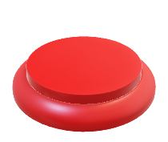
Version Control
Modules
Dev
version 1.0
Environment = dev
Instance count = 1
Instance size = t2.small
Dev Configuration
Version = 1.0
Environment = Dev
Instance Count = 1
Instance Size = t2.small
State file
Dev-instance-1
No Changes
plan
ENTIRE HISTORY OF YOUR INFRASTRUCTURE CAPTURED IN THE COMMIT LOG
t2.small
Tst
version 1.0
Environment = tst
Instance count = 1
Instance size = t2.small
Tst Configuration
Version = 1.0
Environment = tst
Instance Count = 1
Instance Size = t2.small
Tst-instance-1
State file
No Changes
plan
t2.small
prd Configuration
version = 1.0
Environment = prd
Instance Count = 2
Instance Size = t2.large
Prd Configuration
version = 1.1
Environment = prd
Instance Count = 2
Instance Size = M5.large
Prd
version 1.1
Environment = prd
Instance count = 2
Instance size = m5.large
State file
prd-instance-1
prd-instance-2
No Changes
plan
m5.large
m5.large

Slide 17
Benefits of using terraform
Automation
Documentation
Validation
Version Control
Reuse

Slide 18
Reuse
PACKAGE YOUR INFRASTRUCTURE INTO REUSABLE MODULES
Infrastructure
Environments
Dev
Database
variables.tfvars
terragrunt.hcl
EC2-Instance
variables.tfvars
terragrunt.hcl
Tst
Database
Variables.tfvars
Terragrunt.hcl
EC2-Instance
Variables.tfvars
Terragrunt.hcl
Prd
Database
Variables.tfvars
Terragrunt.hcl
EC2-Instance
Variables.tfvars
Terragrunt.hcl
General Resources
Non-prd
Account.tfvars
General.tfvars
Global.tfvars
Prd
Account.tfvars
General.tfvars
Global.tfvars
ec2-Instance dev environment variables
{
“Instance-count”: 1
“environment”: “dev”
“Instance-type”: “t2.small”
}
Modules
Database
Main.tf
Outputs.tf
Vars.tf
EC2-Instance
Main.tf
Outputs.tf
Vars.tf
INSTEAD OF DOING
EVERY DEPLOYMENT
FOR EVERY PRODUCT
IN EVERY ENVIRONMENT FROM SCRATCH, YOU CAN BUILD ON TOP OF EXISTING MODULES
ec2-Instance main.tf
resource "aws_instance" ”ec2" {
name = “${var.environment}-instance-${count.index}”
count = var.instance-count
instance_type = var.instance
}

Slide 19
Fast forward 6 months…

Slide 20


Infrastructure has additional resources e.g. database, alb, autoscaling, etc
All created with terraform created across multiple environments
Now you can quickly and easily view the configuration within each
Environment by simply looking at the terraform code
Dev Configuration
Environment = Dev
Instance Count = 1
Instance Size = t2.small
Much easier to manage the infrastructure and train new employees

